Slide 1





Analysis Tutorial
By Alia

Slide 2
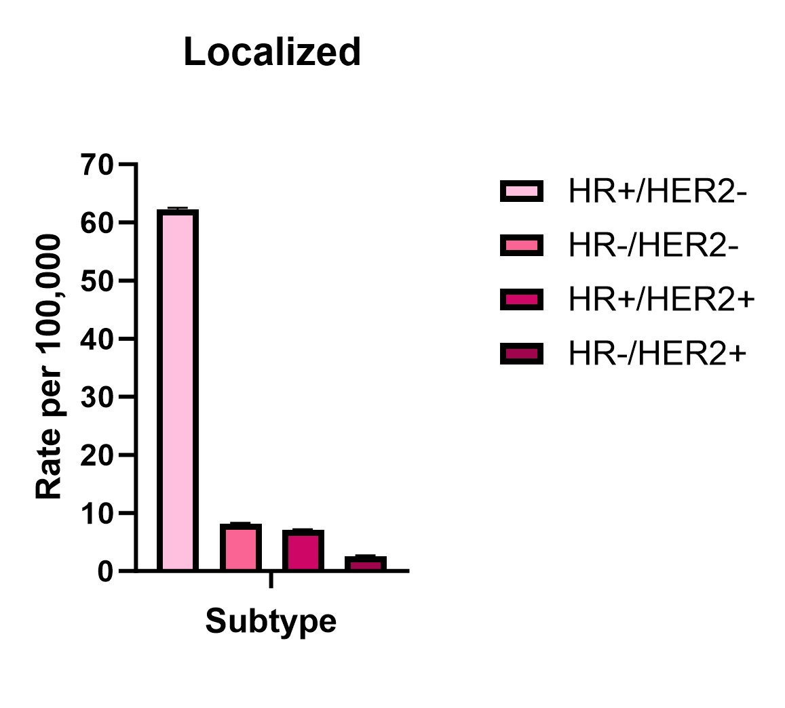
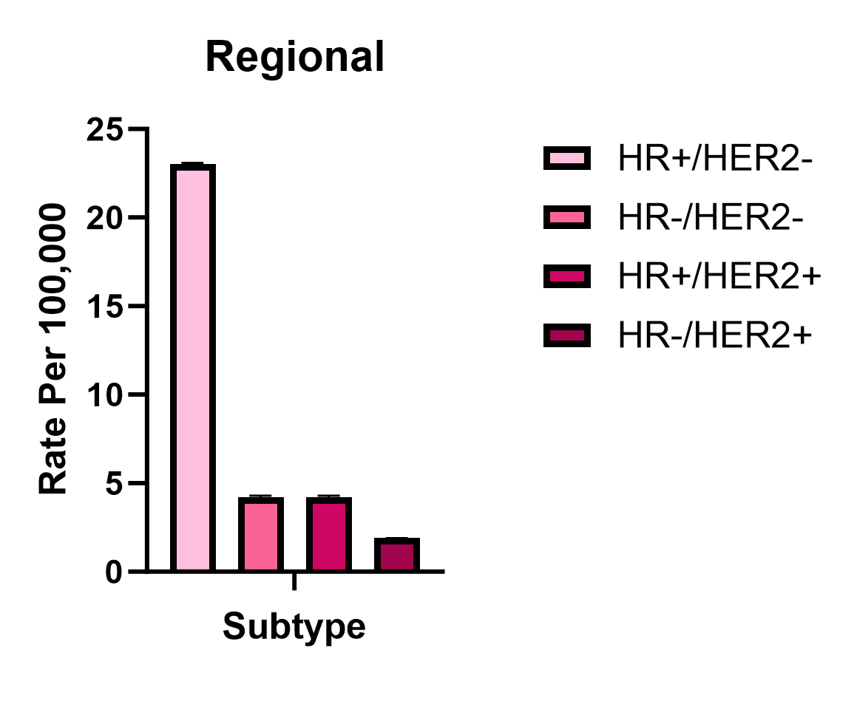
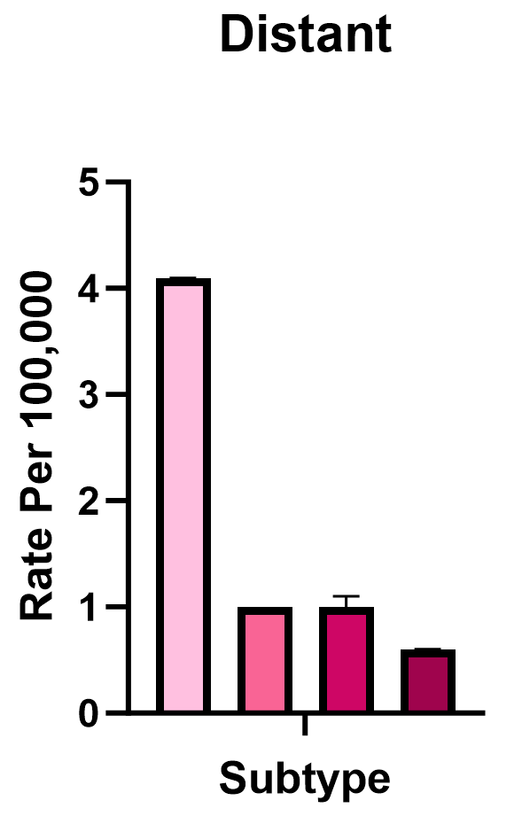
Breast Cancer
Breast cancer is the second leading cause of cancer related deaths.
Distant breast cancer tumors decrease survivability.
5 Year Breast Cancer Incidence Rates 2017-2021

Slide 3
Main Questions:
How does the incidence rate of breast cancer vary across different countries?
How does other demographic data impact the incidence rates of breast cancer?
What other visualizations can be made to better understand breast cancer significance?

Slide 4
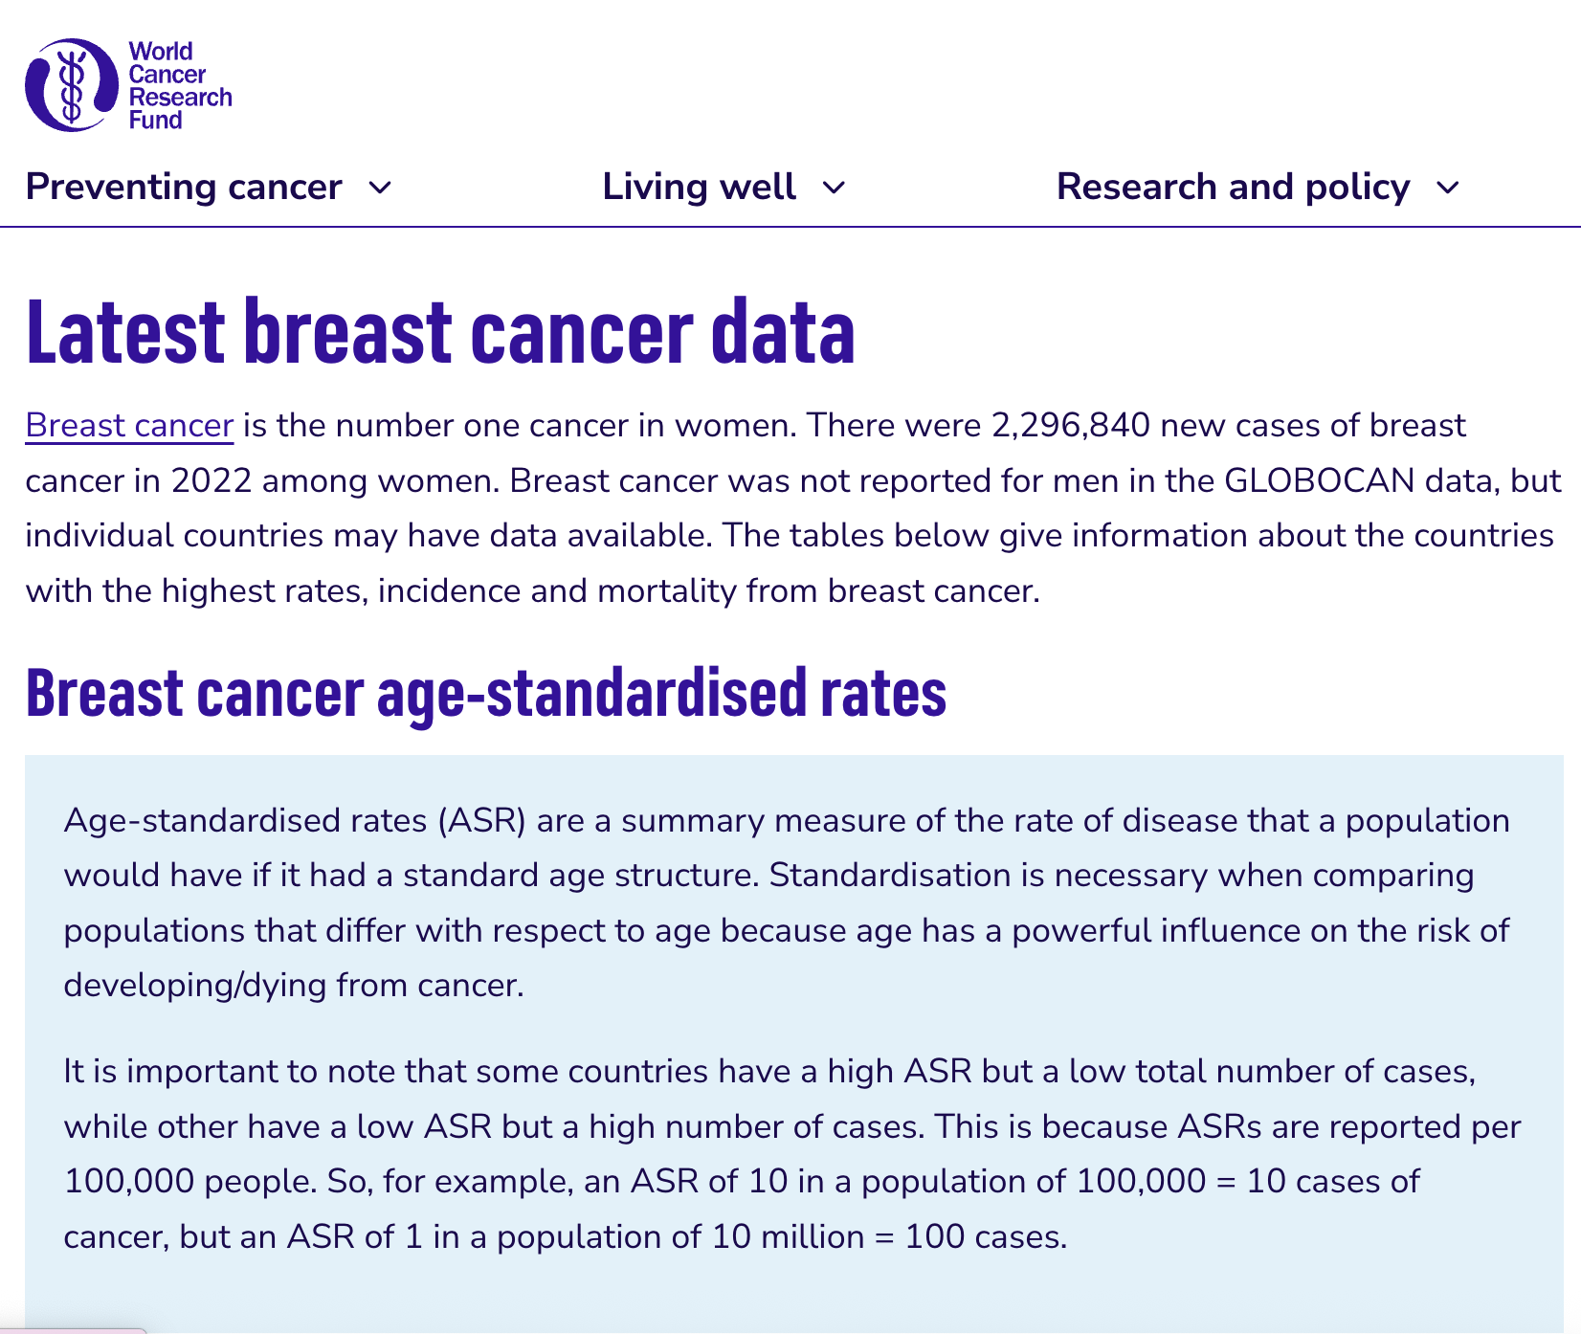
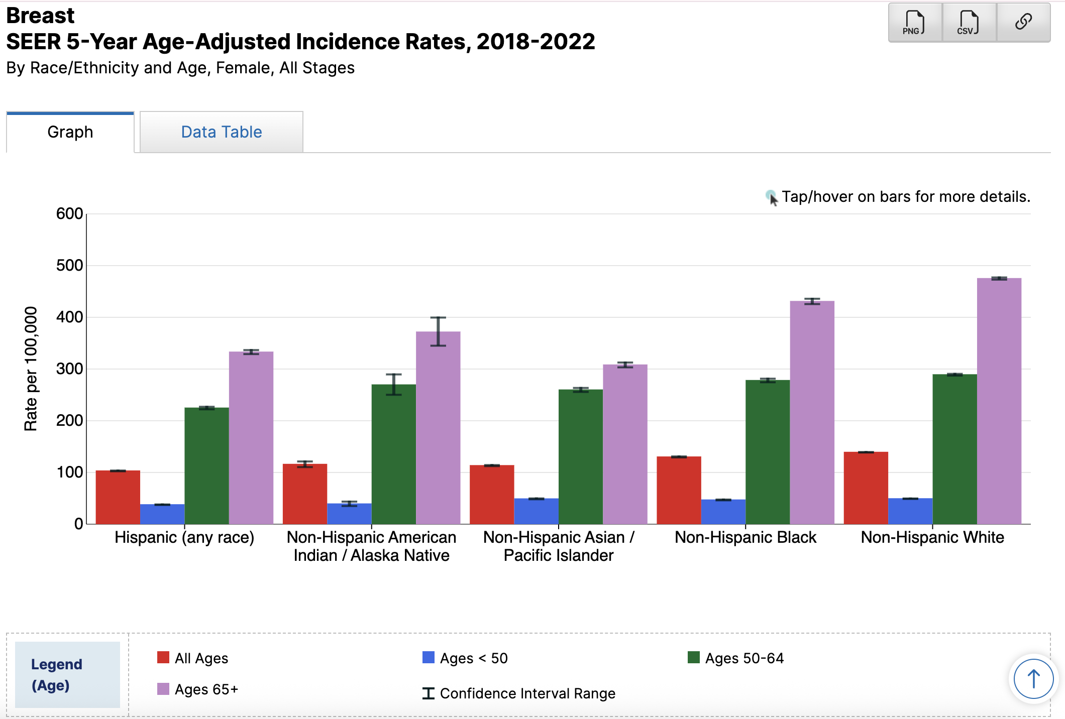
Data Utilized:
World Cancer Research Fund ASR data
SEER Breast Cancer Data

Slide 5
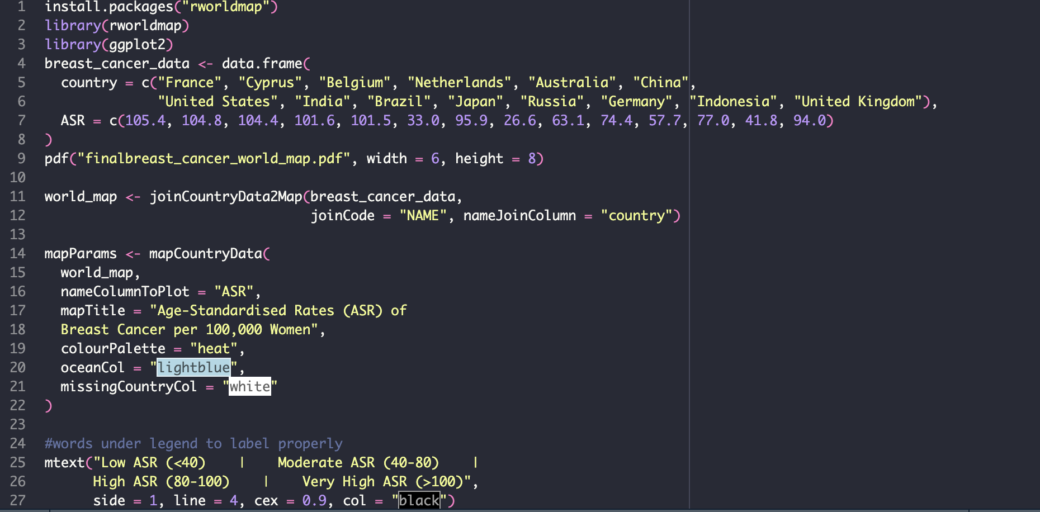
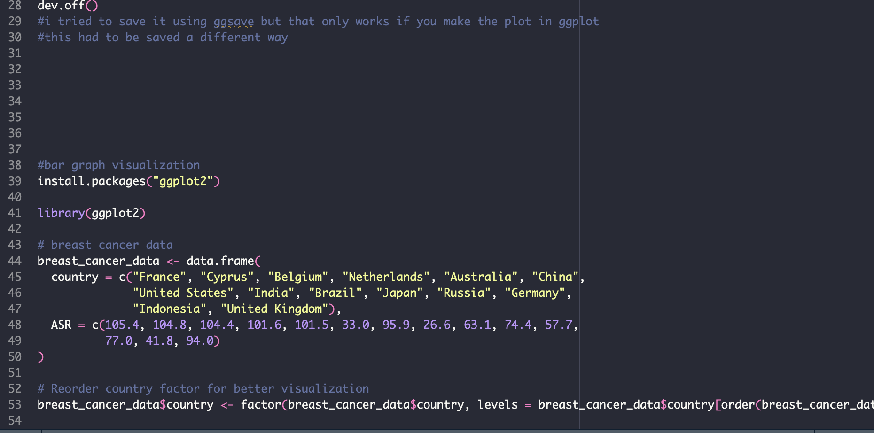
World Map Visualization
Notes:
- Had to figure out how to save when using a diff method of making graphs and stuff

Slide 6
World Map Visualization
Notes:
- Had to use this data as it was somewhat difficult to find relevant data to use for this

Slide 7

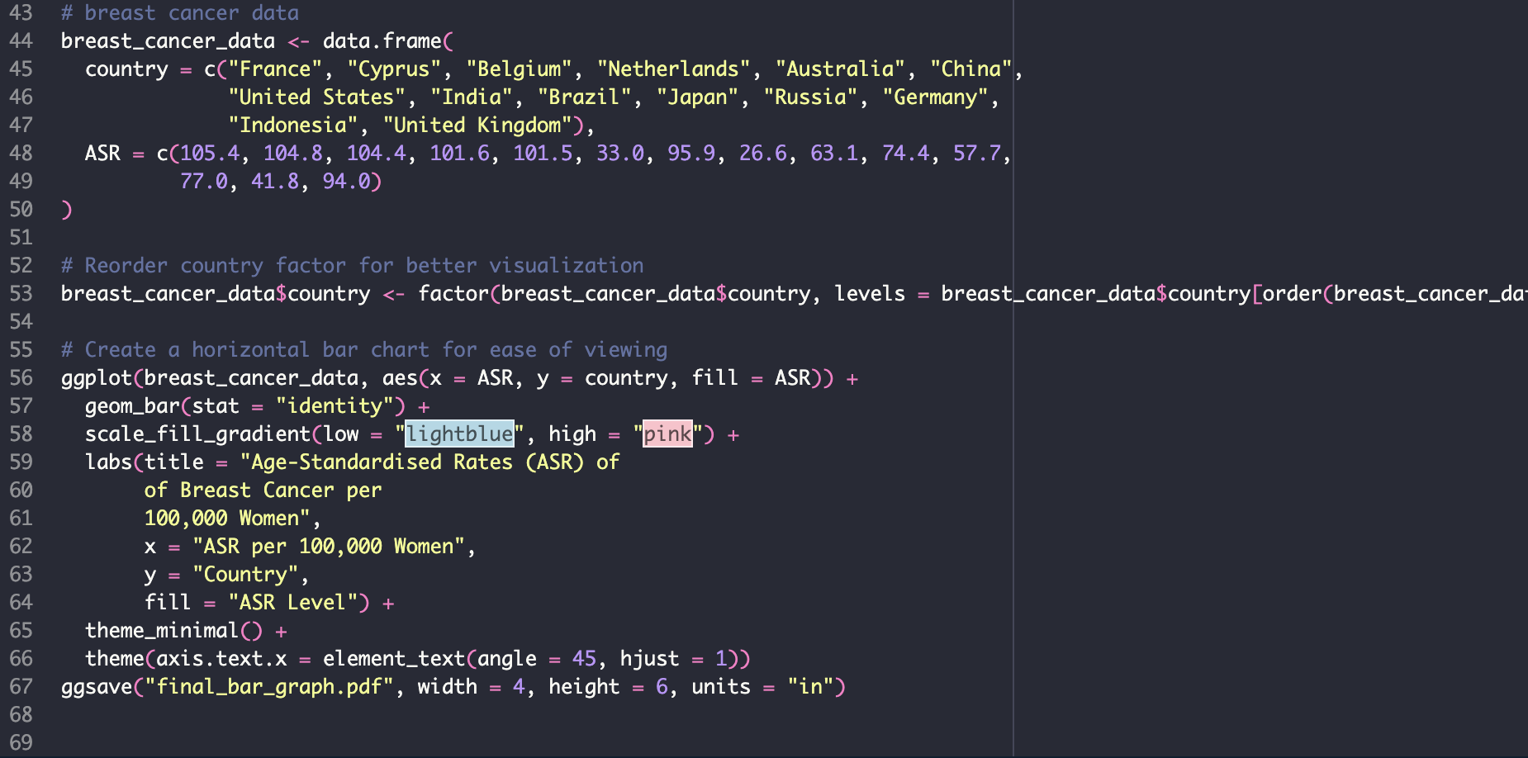
ASR Bar Graph Visualization

Slide 8
ASR Bar Graph Visualization

Slide 9
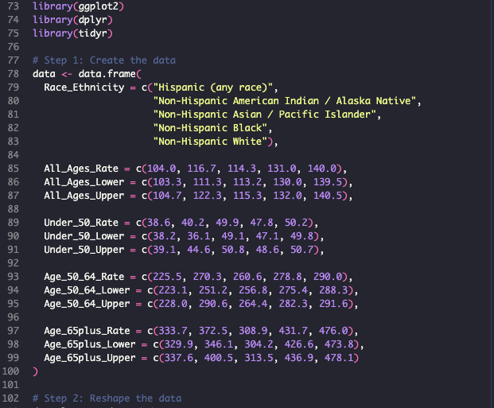
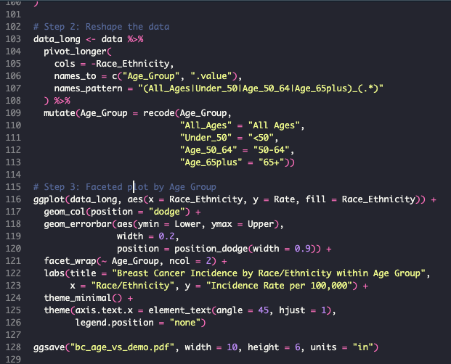
Demographic and Incidence Visualization

Slide 10
Demographic and Incidence Visualization

Slide 11
Manipulate SEER data to include in lab meeting presentations
Obtain various similar data sets to compare these visualizations to
Modify single cell RNA visualizations with basic knowledge in R to be ideal for various presentations
Utilize R to create heat maps and dot plots with lab data
Future Directions
Notes:
- Use as background information

Slide 12
Works Cited:
Bhatnagar, S. R. (2024, August 17). Plot Cumulative Incidence and Survival Curves. Plot cumulative incidence and survival curves. https://cran.r-project.org/web/packages/casebase/vignettes/plotabsRisk.html
Breast cancer statistics. World Cancer Research Fund. (2025, February 5). https://www.wcrf.org/preventing-cancer/cancer-statistics/breast-cancer-statistics/
Holtz, Y. (n.d.). Help and inspiration for R charts. The R Graph Gallery. https://r-graph-gallery.com/
liao, ling. (2025). Inequality in breast cancer: Global Statistics from 2022 to 2050. The Breast. https://doi.org/10.2139/ssrn.4976619
Nordmann E, McAleer P, Toivo W, Paterson H, DeBruine LM. Data Visualization Using R for Researchers Who Do Not Use R. Advances in Methods and Practices in Psychological Science. 2022;5(2). doi:10.1177/25152459221074654
Schneider, T. (2023, November 8). Breast cancer subtypes analysis with R. Medium. https://medium.com/@taylorschneider_61189/breast-cancer-subtypes-analysis-with-r-e1d090ab151a
SEER*Explorer: An interactive website for SEER cancer statistics [Internet]. Surveillance Research Program, National Cancer Institute; 2025 Apr 16. [cited 2025 May 2]. Available from: https://seer.cancer.gov/statistics-network/explorer/. Data source(s): SEER Incidence Data, November 2024 Submission (1975-2022), SEER 21 registries.
Zhang, Y., Ji, Y., Liu, S., Li, J., Wu, J., Jin, Q., Liu, X., Duan, H., Feng, Z., Liu, Y., Zhang, Y., Lyu, Z., Song, F., Song, F., Yang, L., Liu, H., & Huang, Y. (2025). Global burden of female breast cancer: New estimates in 2022, temporal trend and future projections up to 2050 based on the latest release from Globocan. Journal of the National Cancer Center. https://doi.org/10.1016/j.jncc.2025.02.002

Slide 13
Thank You

